Slide 1
Development of a computer vision software for the Very Small Size Soccer Robotics League
Rafael Guimaraes de Paula

Slide 2
Introduction
The Very Small Size League is one of the RoboCup soccer leagues where autonomous robots simulate a soccer match with small adjustments in the rules.
The Computer Vision system must be able to identify many objects of interest, make decisions and send the commands to be executed by the robots.
<número>

Slide 3
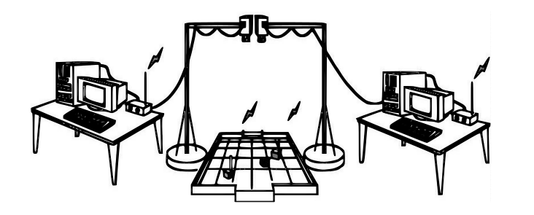
Very Small Size
<número>

Slide 4
Objectives
Develop a system:
reliable
accurate
tolerant to brightness variation
<número>

Slide 5
Development Tools
OpenCV
It is an Open Source Computer Vision Library, having more than 2500 optimized algorithms.
Qt Framework
It is a cross-platform framework, mainly used for develop applications with graphical user interfaces.
<número>

Slide 6
OpenCV
OpenCV's application areas include:
2D and 3D feature toolkits
Egomotion estimation
Facial recognition system
Gesture recognition
Human–computer interaction (HCI)
Mobile robotics
Motion understanding
Object identification
Segmentation and recognition
Stereopsis stereo vision: depth perception from 2 cameras
Structure from motion (SFM)
Motion tracking
Augmented reality
<número>

Slide 7
System Modules
<número>

Slide 8
Vision Module
The vision module is composed by 5 steps:
Settings
Border Adjustment
Calibration
Field Adjustment
Game
<número>

Slide 9
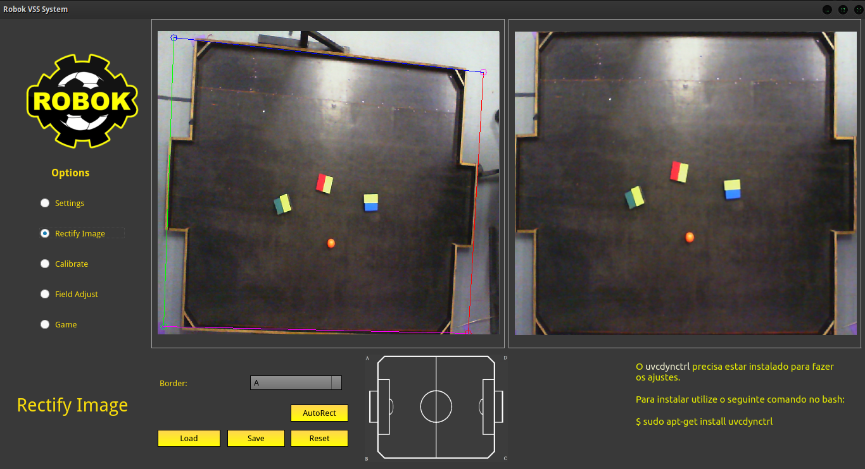
O Sistema O Sistema O Sistema GUI
<número>

Slide 10
Techniques
Image Rectification
Thresholding
Erode
Dilate
Flood fill
<número>

Slide 11
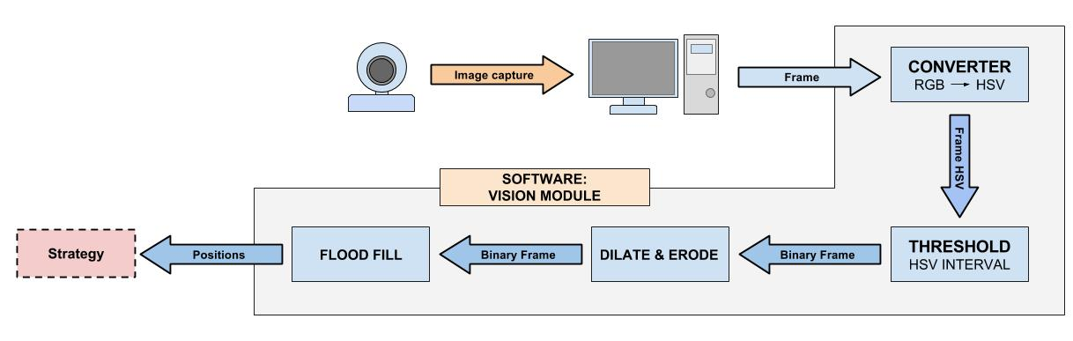
Techniques
<número>

Slide 12
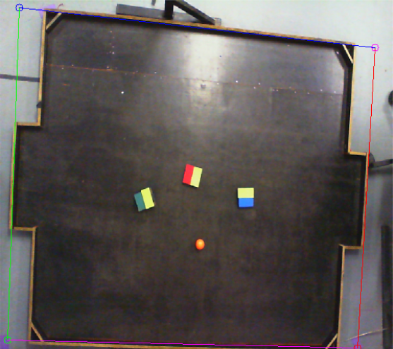
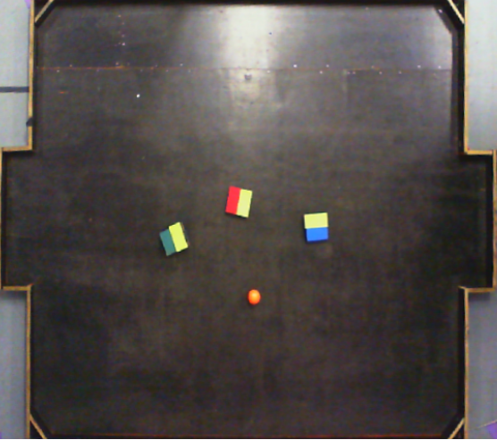
Image Rectification
Image rectification is a transformation process used to project a image onto a common image plane. It performs a projection of all the points inside the trapezium limited by the selected points and, in this specific case, generates an image with the same dimensions from the original image.
<número>

Slide 13
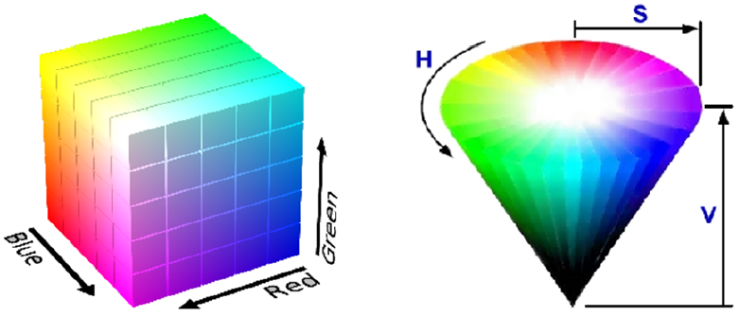
RGB - HSV Conversion
The HSV (Hue Saturation Value) color model allows the application to deal with brightness in only one parameter(Value).
<número>

Slide 14
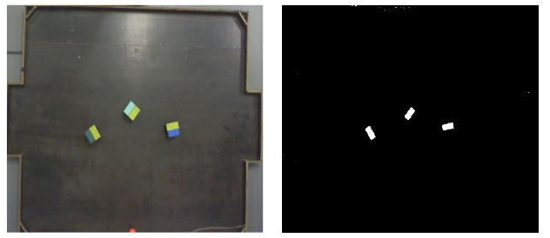
Thresholding
This method replaces all the image pixels within the predefined HSV bandwidth with white pixels and the others with black pixels.
<número>

Slide 15
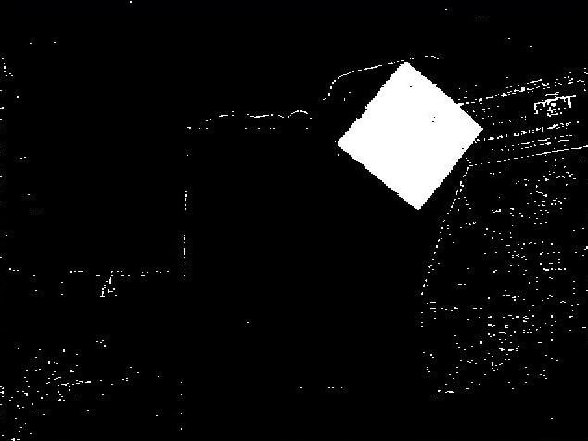
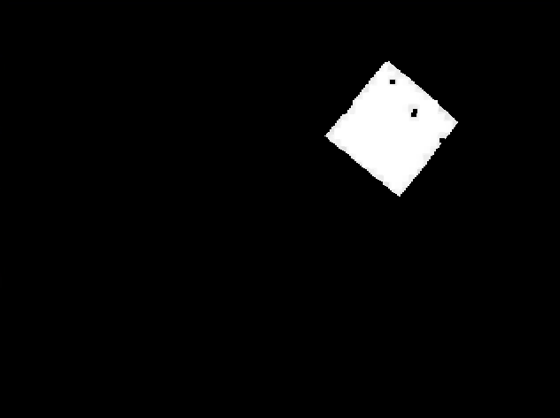
Erode
Reduces all the white area in the binary image. All the isolated white pixels and little white areas are filtered.
<número>

Slide 16
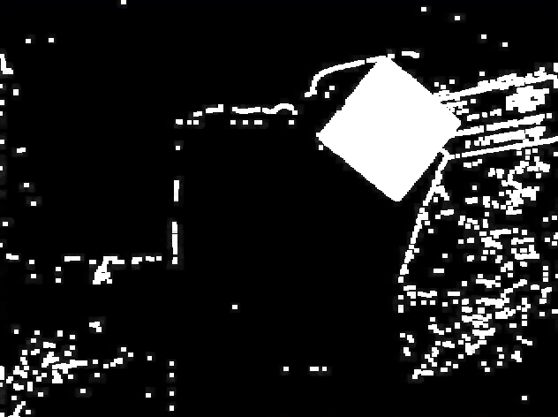
Dilate
This process does the opposite from the previous one, expanding all the white areas of the image.
<número>

Slide 17
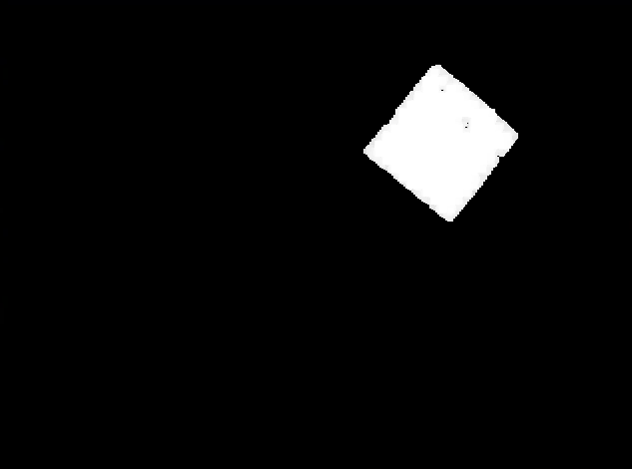
<número>

Slide 18
Flood Fill
Gradually searches the image for a white pixels;
If a white pixels is found, the algorithm looks for all white pixels that are connected to the start white pixel;
The average of the position of the white pixel agglomeration is calculated, and this average represents the center of the target object.
<número>
Notes:
adicionar imagens

Slide 19
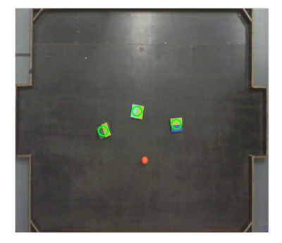
Result
<número>

Slide 20
Thank You!
<número>

